Slide 1
Welcome to

Slide 2
Introduction
Today’s work is all about apprenticeships. At Beacon, we take pride in our careers programme and we want to ensure that when you leave us in year 11, you know about all of the options available to you. Apprenticeships are one of those options.
The following tasks are to help you understand
What apprenticeships are
What apprenticeships are available
How apprenticeships link to the subjects you study in school
If this is something that you would like to do when you leave Beacon Academy.
If you complete all of the tasks to the best of your ability and submit your work to careers@beaconacademy.co.uk in one email, a prize will be awarded to the best complete set of work.

Slide 3
Activity – Think about…
What do you want to do when you leave school?
What is an apprenticeship?
What types of apprenticeship do you think exist?
Have you considered this as an option for when you leave school?

Slide 4
Watch the video: Apprenticeships and T-Levels Explanation Video (Copy and paste the link into your browser)
https://amazingapprenticeships.com/resources/

Slide 5
Task 1

Slide 6
Watch the video: A to Z of Apprenticeships Video (Copy and paste the link into your browser)
https://vimeo.com/499561236

Slide 7
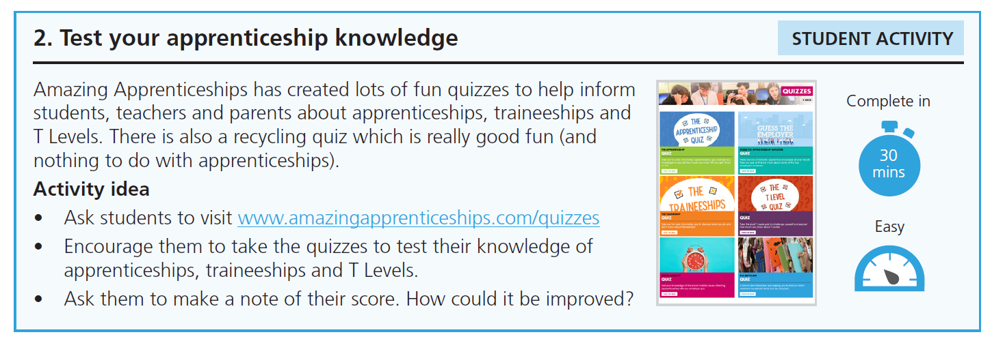
Task 2

Slide 8
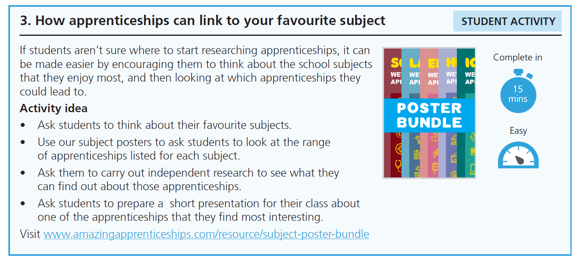
Task 3

Slide 9
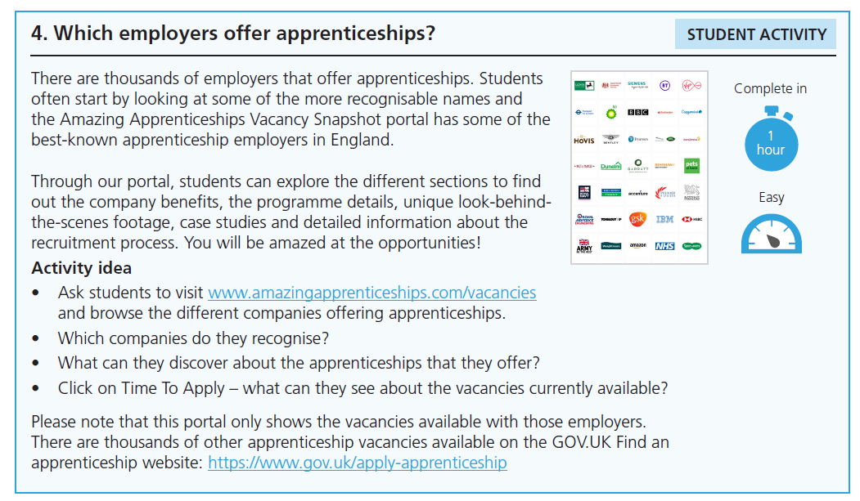
Task 4

Slide 10
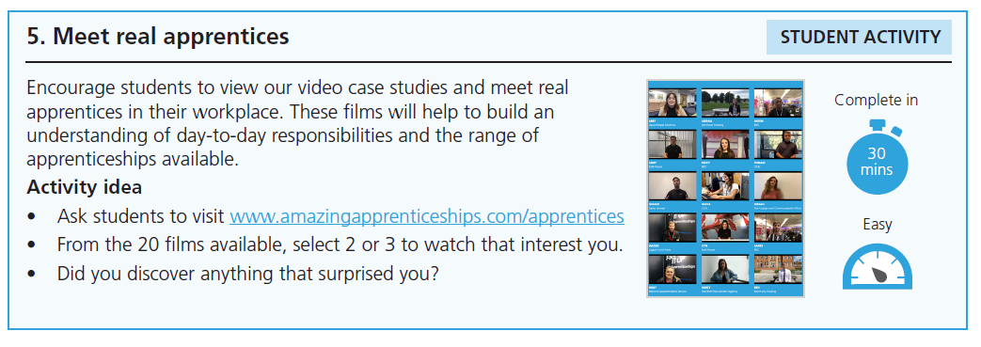
Task 5

Slide 11
Task 6 – Time to apply
Research and create either of the following:
A letter of application
CV
In your letter or CV you should include:
Your personal information (name, date of birth, address, email address and phone number)
Your qualifications (what do you intend to leave school with? E.g. GCSE Maths: Grade 9)
Your experience (Anything you have done that would be useful experience in your chosen career e.g. Extreme Lego would give good experience to someone wanting to go into construction).

Slide 12
Task 7 – Your ideal apprenticeship
Using the information you have seen on other apprenticeship adverts today, create your own apprenticeship advertisement for your ideal apprenticeship.
Use the information on the websites we have looked at today to help you with the information that you need to include.

